Slide 1
Overview and Importance of Algorithms

Slide 2
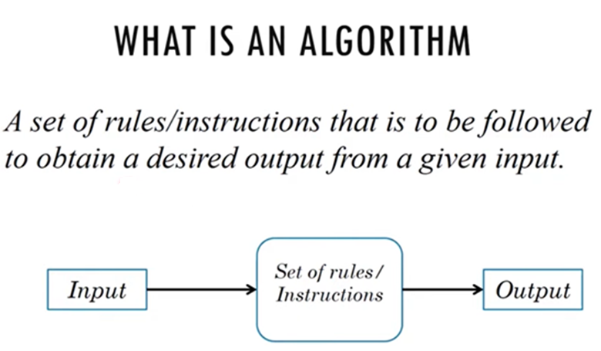

Slide 3
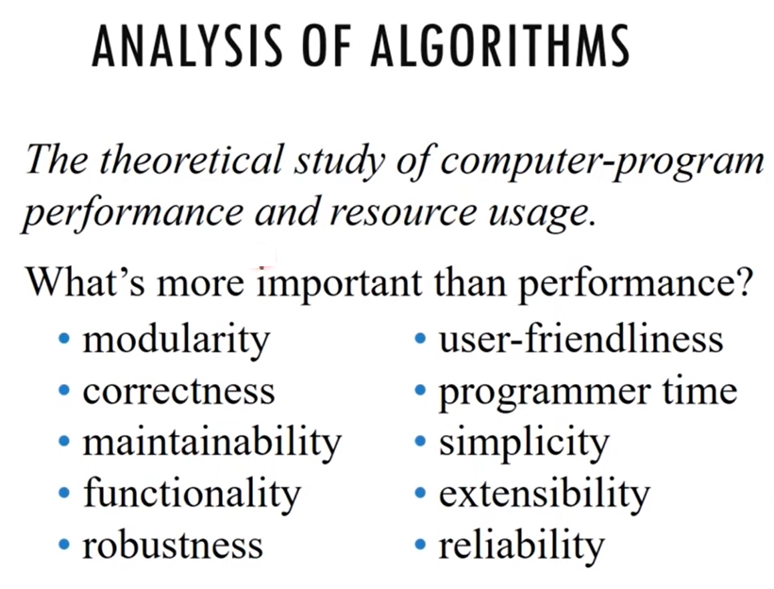

Slide 4
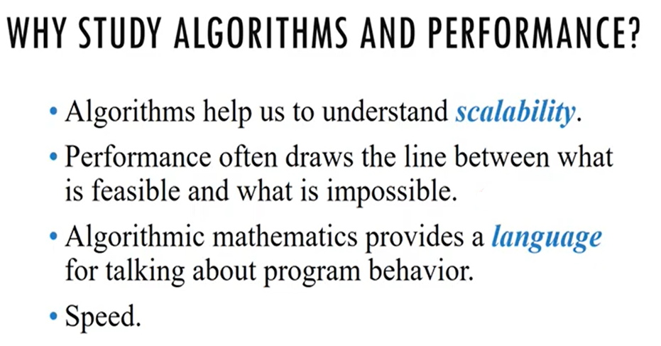

Slide 5
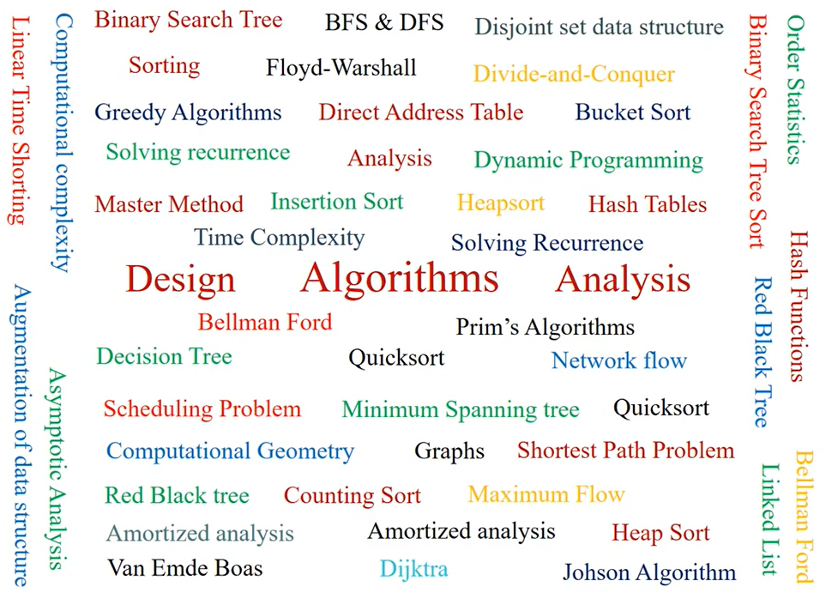

Slide 6
Importance of algorithm
Data structure is an orderly arrangement of data in computers to use it in a more efficient manner.
It’s a collection of data objects that allows storing, organizing, and retrieving data on systems

Slide 7
Relationship between Data Structure and Algorithm
Both are interrelated components
An algorithm appliers to a particular data structure, while the right data structure helps to drastically improve the performance of the algorithm
Major categories of algorithms in relation to DS
Search
Insert
Sort
Update
Delete

Slide 8
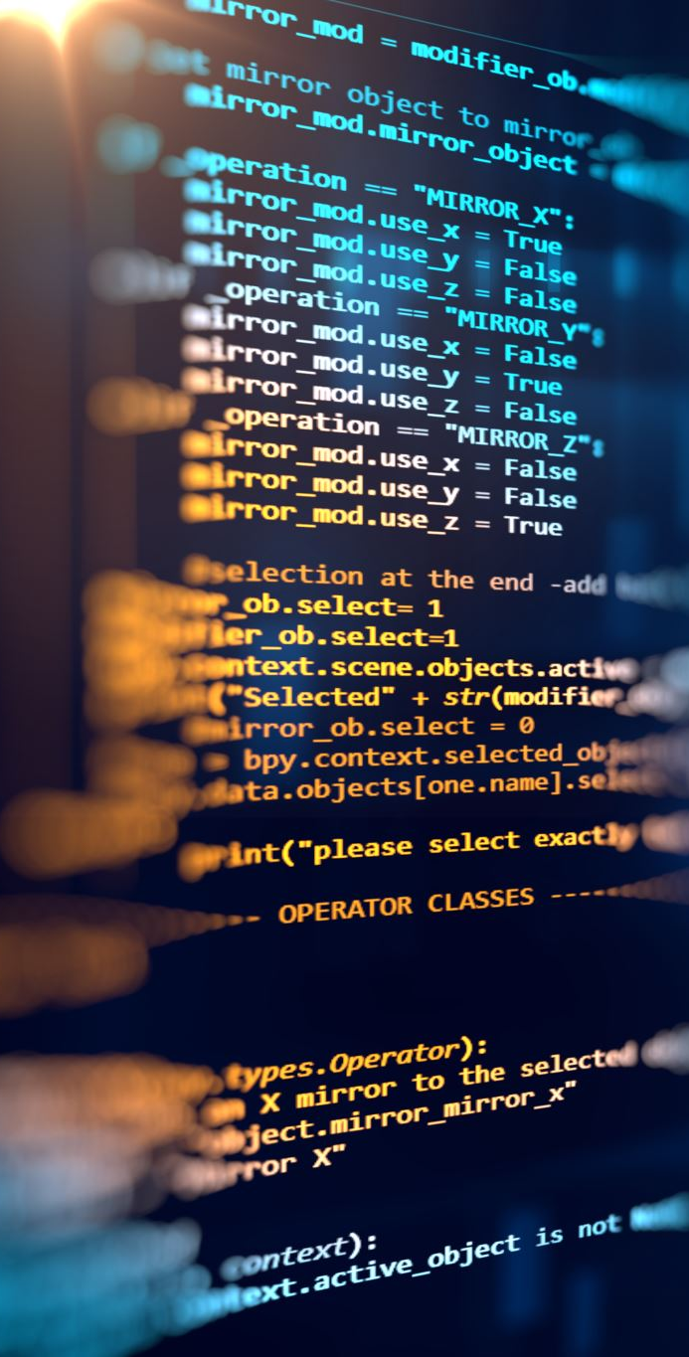
Importance of Learning DS and Algorithm
Most pivotal topics for programmers and computer science graduates.
Reduces coding cost & enhances data accuracy
Improve problem solving abilities
Expose to different problem-solving techniques
Competent in DS can resolve tasks related to data processing, automated reasoning or calculations

Slide 9

Various stages of algorithm development for solving a problem
The Four Major Stages of Algorithm Analysis and Design
1
Design: The first stage is to identify the problem and thoroughly understand it.
2
Analyze : Once you have the basic framework of the algorithm it's time to start analyzing how efficient the code is in solving the problem.
3
Implement : Writing and coding the algorithm is the next step in the process. To write the algorithm efficiently you have to know exactly what each line of code is going to accomplish when the program is executed
4
Experiment: Once the algorithm is designed and coded go back and experiment with different variables in the algorithm. Try with different data to ensure correctness and efficiency of the algorithm.
5

Slide 10
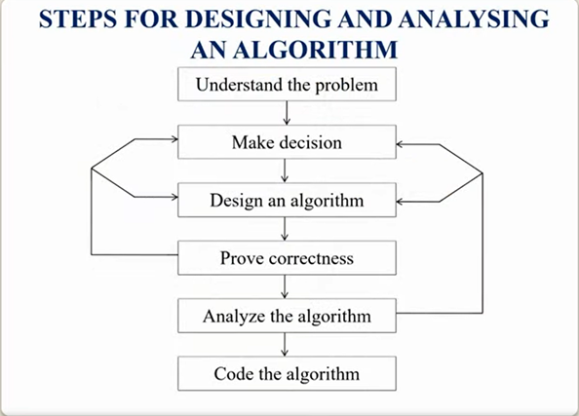

Slide 11
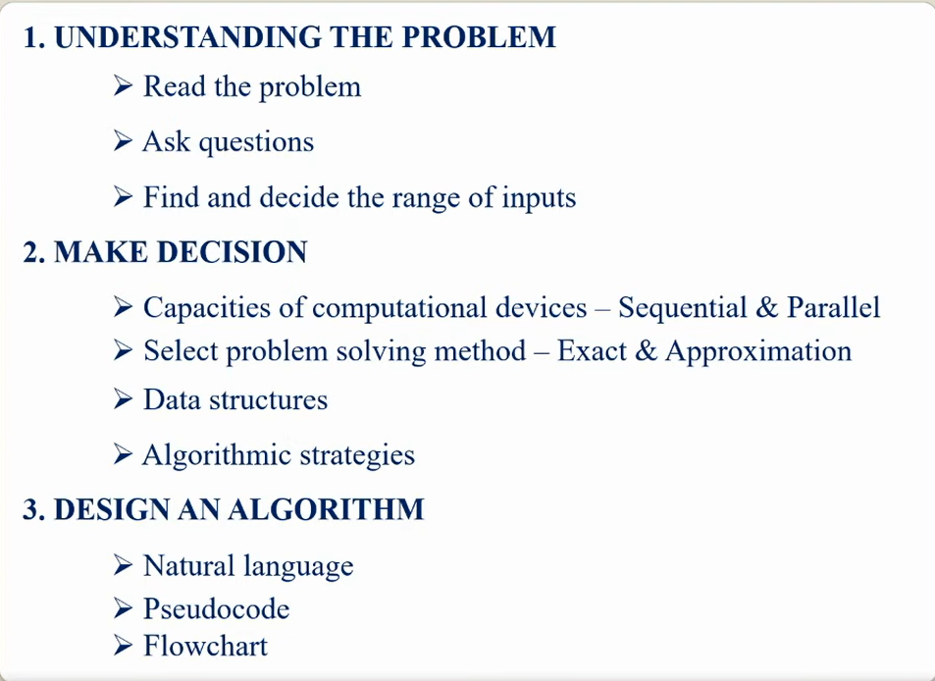

Slide 12
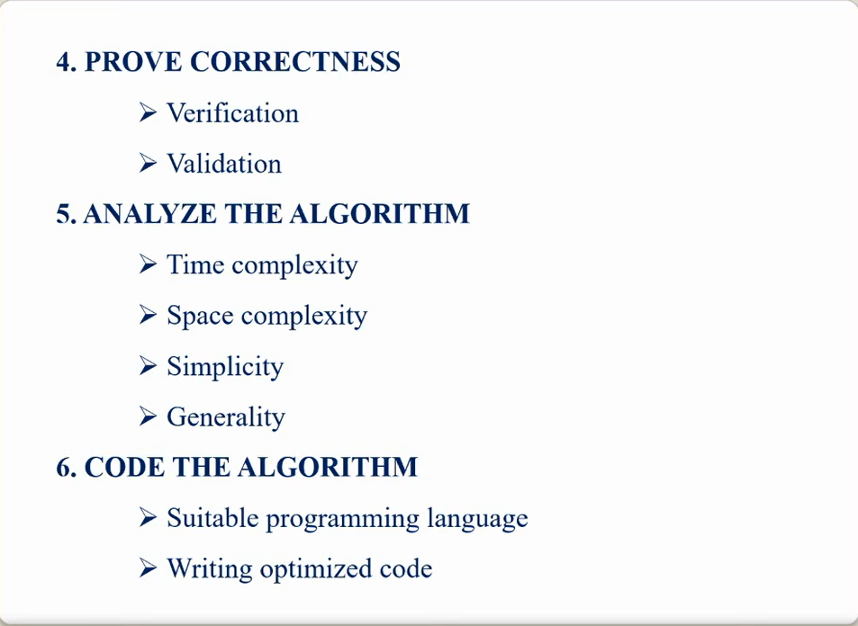

Slide 13
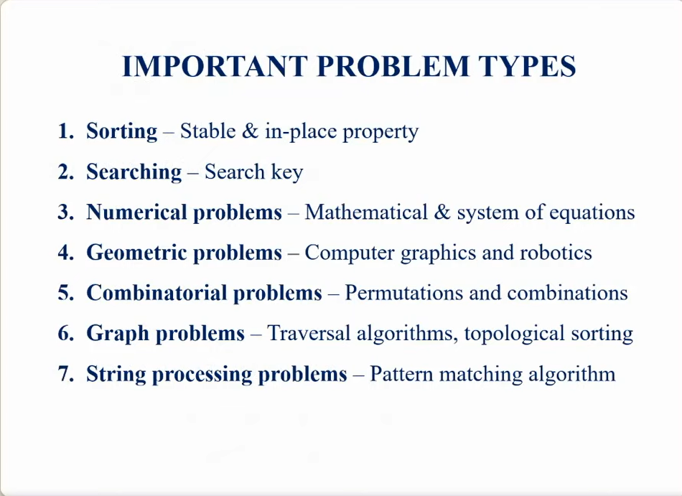

Slide 14
Space and Time Complexity
Space complexity : is the process of determining a formula for prediction of how much memory space will be required for the successful execution of the algorithm.
The memory space we generally consider is the space of primary memory

Slide 15
Time complexity is defined as the process of determining a formula for total time required towards execution of that algorithm.
The calculation will be independent of implementation details and programming language.

Slide 16
How to analyze an algorithm
Time
Space
Network
Power
CPU Registers

Slide 17
Analysis of algorithm
Algorithm swap ( A , B )
{
Temp = A;
A = B;
B= Temp;
}
TIME SPACE

